Slide 1

Mad Numbers
Abdulkayium shaikH
Aayushi mali
Sunny patel
Saisree bhamidipati
Khushbu soni

Slide 2

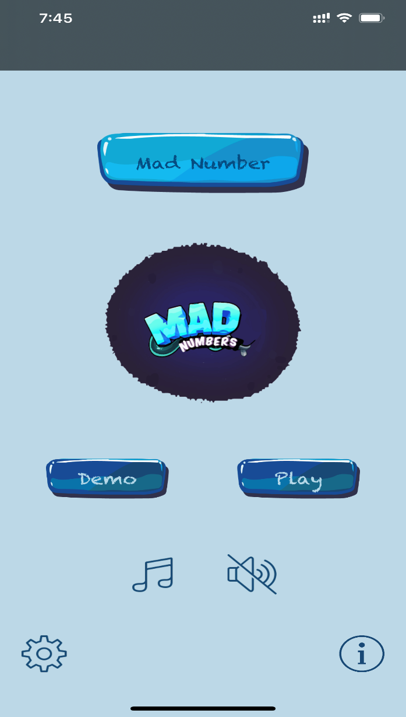
Overview
It is a very simple logical number slider game.
It is very simple but difficult puzzle that will make you relax and fun.
You slide the slider to check for random number !!
Get ready for more challenges !!

Slide 3


Do You like playing GAMES??

Slide 4

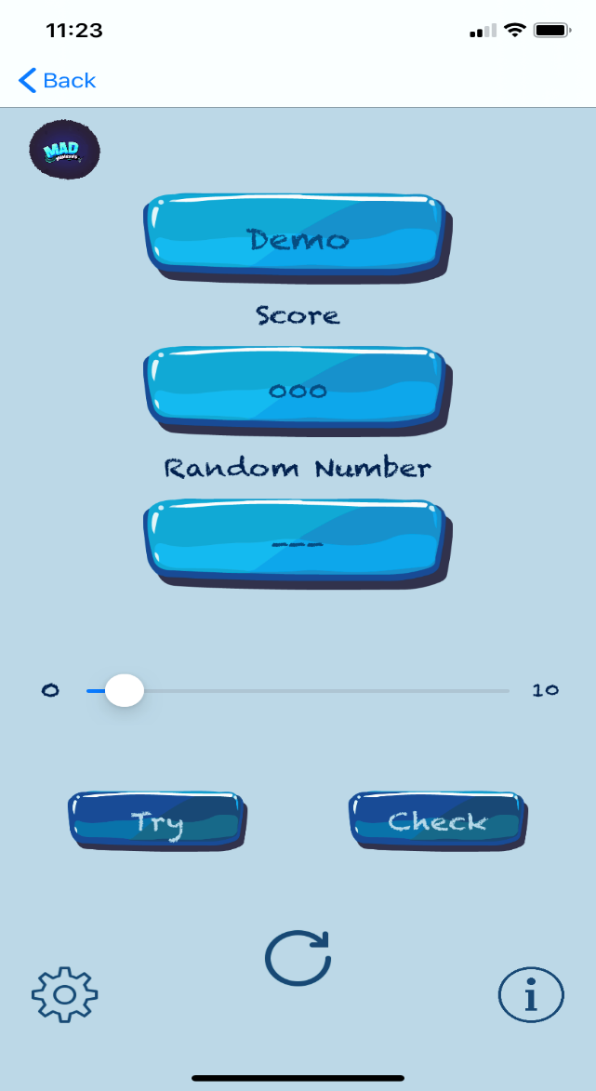
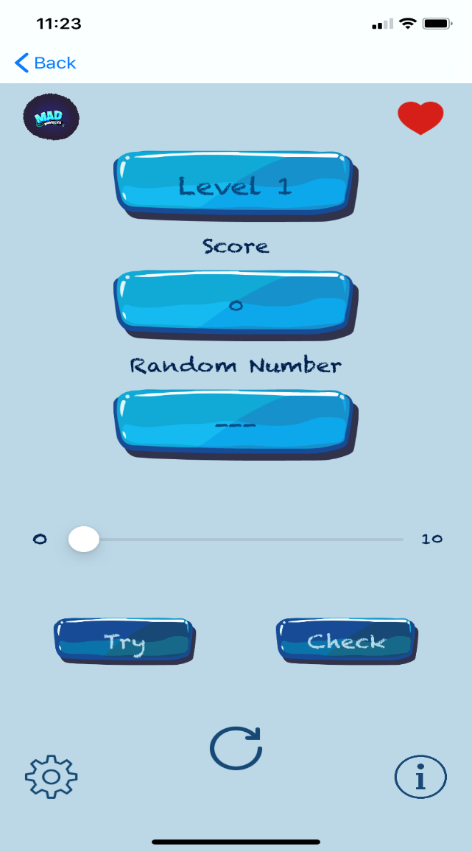
Screenshots about the GAME

Slide 5
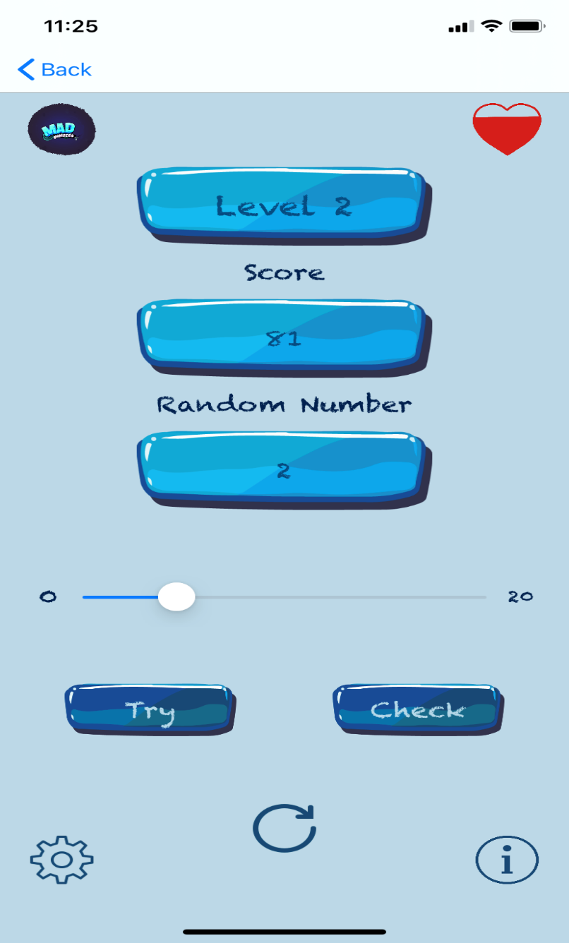

Difficulty of LEVELS

Slide 6
Let’s TRY some DEMO!!!!

Slide 7
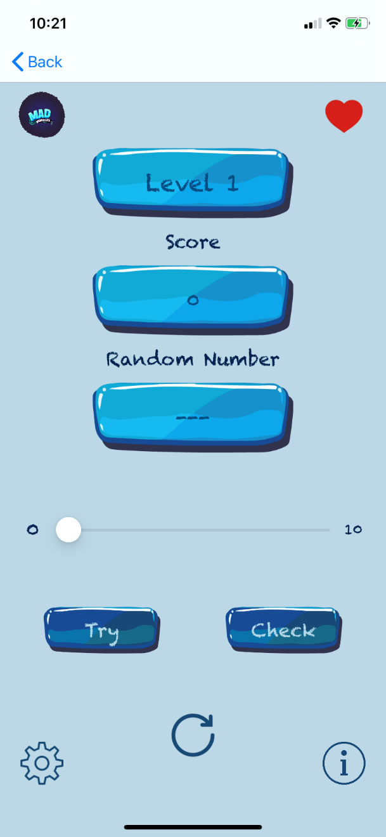
How to PLAY
You need to slide the slider(Left - Right) to select numbers.
When you are sure about the number, Click on check to match the random number.
When you click on try, Different random number is generated.

Slide 8
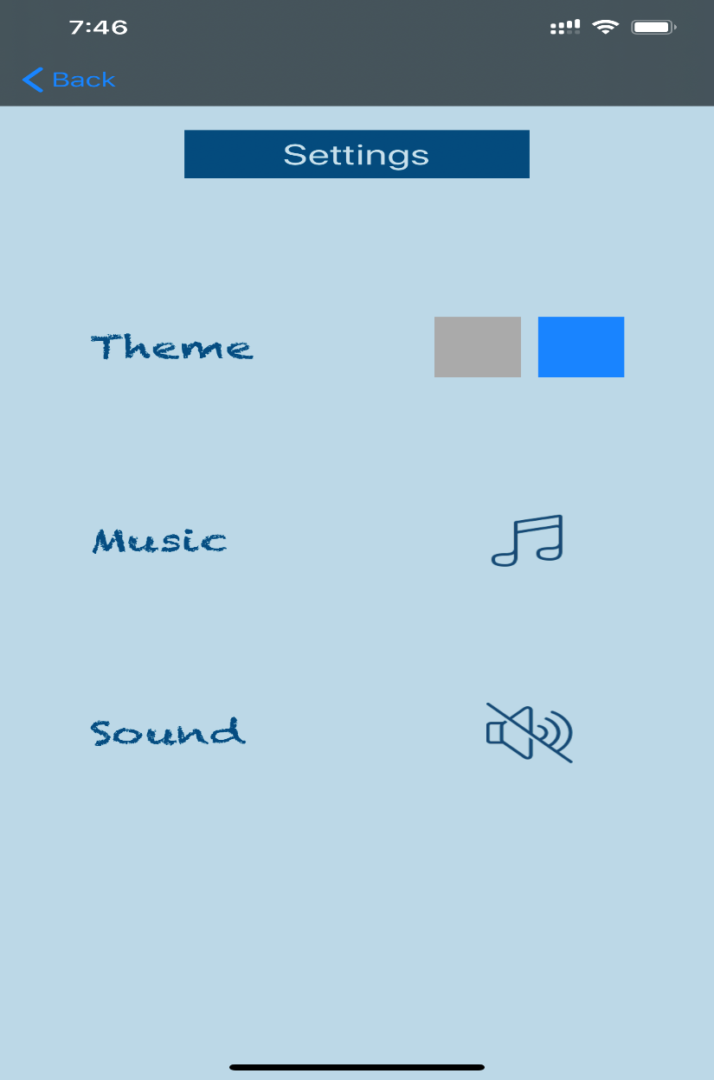
Settings Screen

Slide 9
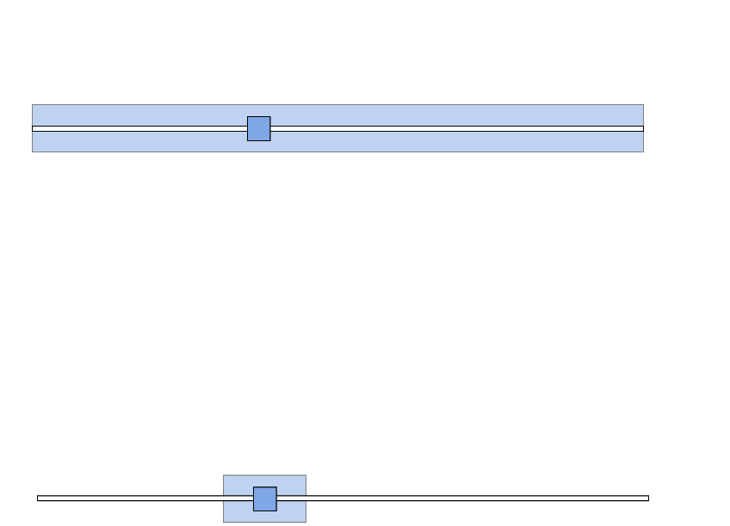
Score of Game

Slide 10
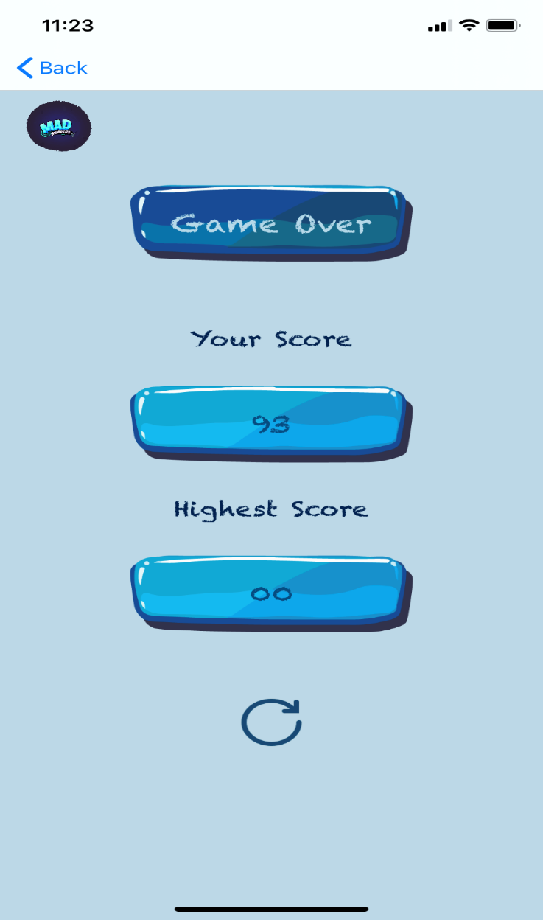
Game over Screen

Slide 11




Additional Features of Game
Supports two modes(i.e. Demo, Lives)
Difficulty will increase as user will go up in level.
In live mode, users have maximum two lives, so after two try game will be over.
User can reset the number by clicking on reset button.

Slide 12


Try the Game NOW !! FREEEE!!!!!!

Slide 13
Thank You !!

